Slide 1
Behavioral Health Carve-In Ohio Medicaid Provider Training

Slide 2
Behavioral Health Carve-In Ohio Medicaid
Today: Behavioral Health Carve-In 7/1/2018
Services & Benefits
Prior Authorization & Notification Requirements
Billing and Claims Submissions
Claim Reconsideration Process
Provider Resources
How to Contact Us
Past: Behavioral Health Redesign 1/1/2018
**Please note the ODM material in this presentation is current as of ODM’s Behavioral Health Provider Manual published on 1/30/18.**
Notes:
**Stress bh.medicaid.ohio.gov/manuals**

Slide 3

Our United Culture

Slide 4
Introduction to Optum
United Behavioral Health (UBH) was officially formed on February 2, 1997, via the merger of U.S. Behavioral Health, Inc. (USBH) and United Behavioral Systems, Inc. (UBS).
United Behavioral Health, operating under the brand Optum, is a wholly owned subsidiary of UnitedHealth Group. Optum is a health services business. You will see both UBH and Optum in our communications to you.
Optum is contracted with UnitedHealthcare Community Plan to administer the behavioral health portion of the Ohio Department of Medicaid’s behavioral health benefit beginning on July 1, 2018. This includes both mental health and substance use disorders.

Slide 5
Behavioral Health Services

Slide 6
Behavioral and Medical Integration
Our Goal: Achieve medical and behavioral health care integration for all members
Behavioral providers are asked to refer members with known or suspected and untreated physical health problems or disorders to their Primary Care Physician for examination and treatment
Primary Care Physicians are asked to identify and refer members with known or suspected and untreated mental health or substance use disorders for behavioral health examination and treatment
Our Goal: Achieve integration of treatment for mental health and substance use disorder conditions
Our care management program assists members with complex medical and/or behavioral health needs in the coordination of their care
All members are expected to be treated from a holistic standpoint; this is especially true for high-risk, high-service utilizers and other members with complex needs

Slide 7
Integrated Care Team
The care team will consist of program specialists who can “flex” to quickly address the needs of the member
Division of Public Health
Division of Behavioral Health
Juvenile Court & Probation
Division of Development Disabilities
Optimal health and well-being
PT/OT
Division of MLTC
Pharmacist
Integrated care is…
a focus on the whole-person: specifically how the physical, behavioral and social needs of a person are inter-connected to maintain good health
Aligned to the delivery system
Care focused on supporting the physician/practitioner to member relationship
Data lead
Social worker
Personal Support System
Maternity RN
Community health worker
County Health Departments
Behavioral health advocate
Transplant RN
Heart failure RN
Network advocate
Peer Support
Child & Family Services
Transition support
General RN
Member Services Advocate
Psychologist
Member
Member’s PCP
Psychiatrist

Slide 8
Role of the Care Manager
The care manager helps members with Serious and Persistent Mental Illness (SPMI), complex behavioral health, and co-morbid medical conditions connect with needed services and resources
Care managers collaborate and partner with individuals in the development of a comprehensive plan of care which coordinates the following:
Therapeutic services (therapy, medication management)
Community and psychosocial supports (education/support regarding illness, coordination with support system, other supportive services)
Coordination of care between physical and behavioral health providers and clinicians
Recovery and Resiliency Services (peer support, development of a crisis/recovery plan, life planning activities)
Other services as appropriate (legal, shelter, basic needs, etc.)
For members with SPMI:
Tailored engagement to support whole person treatment/medication follow up
Development of a communication strategy for coordination between family, service providers and community service organizations
Individualized communication about service gaps

Slide 9
Covered Mental Health Services
Respite (Managed Care only)
Screening, Brief Intervention & Referral (SBIRT)
Assertive Community Treatment (ACT)
Intensive Home Based Therapy (IHBT)
Family Psychotherapy
TBS Group Treatment
Psychological Testing
Therapeutic Behavioral Service (TBS)
Psychosocial Rehabilitation (PSR)
Primary Care Services, Labs, Vaccines
Notes:
Not an all inclusive list, but new with 1/1/18 redesign

Slide 10
Covered Substance Use Disorder Services
Methadone Administration
Buprenorphine Administration
Peer Recovery Support
Intensive Outpatient Group Counseling
Partial Hospitalization Group Counseling
SUD Residential
Primary Care Services, Labs, Vaccines
Notes:
Not an all inclusive list, but new with 1/1/18 redesign

Slide 11
Substance Use Disorder (SUD) COVERAGE
The Ohio Medicaid program has selected the American Society of Addiction Medicine (ASAM) placement criteria as the standard of measure for guiding treatment for individuals with SUD conditions, including individuals with co-occurring MH conditions.
The ASAM criteria has been selected to bring an objective strengths-based evaluation and placement methodology into practice to address individual patient needs, strengths, and supports.
The Ohio Medicaid program covers community-based SUD services to Medicaid beneficiaries provided by SUD programs within Ohio that are certified by Ohio MHAS and enrolled with ODM as a community SUD service provider.

Slide 12
Specialized Recovery Services (SRS) Program [1915(i)]
The SRS program is available to individuals who meet certain financial criteria and have been diagnosed with a serious and persistent mental illness (SPMI).
In addition to full Medicaid coverage, individuals enrolled in the SRS program have access to Individualized Placement and Support-Supported Employment (IPS-SE) and Peer Recovery Support (PRS).
For further information, please see the SRS Provider Manual.

Slide 13
Psychological Testing
Code 96101 (psychological testing) includes the administration, interpretation, and scoring of the tests mentioned in the CPT descriptions and other medically accepted tests for evaluation of intellectual strengths, psychopathology, psychodynamics, mental health risks, insight, motivation, and other factors influencing treatment and prognosis.
Documentation: The medical record must indicate the presence of mental illness or signs of mental illness for:
Detection of neurologic diseases based on quantitative assessment of neurocognitive abilities (e.g., mild head injury, anoxic injuries, AIDS dementia)
Differential diagnosis between psychogenic and neurogenic syndromes
Delineation of the neurocognitive effects of central nervous system disorders
Neurocognitive monitoring of recovery or progression of central nervous system disorders; or
Assessment of neurocognitive functions for the formulation of rehabilitation and/or management strategies among individuals with neuropsychiatric disorders. Psychological testing is indicated as an aid in the diagnosis and therapeutic planning. The record must show the tests performed, scoring and interpretation, as well as the time involved

Slide 14
Psychological Testing Continued
Code 96118 is defined by the CPT narrative and describes testing which is intended to diagnose and characterize the neurocognitive effects of medical disorders that impinge directly or indirectly on the brain.
The content of neuropsychological testing procedure 96118 differs from that of psychological testing (96101, 96111, 96116) in that neuropsychological testing consists primarily of individually administered ability tests that comprehensively sample cognitive and performance domains that are known to be sensitive to the functional integrity of the brain (e.g., abstraction, memory and learning, attention, language, problem solving, sensorimotor functions, constructional praxis, etc.).
Typically, psychological testing will require from four (4) to six (6) hours to perform, including administration, scoring and interpretation. If the testing is done over several days, the testing time should be combined and reported all on the last date of service.
Notes:
Ohio has indicated adhering to the CMS MUEs and associated rules. There is a CMS MUE of 8. This is not over-turned based on medical records or review. This is a hard CMS denial based on CMS NCCI Policy.
The limit stated on slide 19 reflects 8 hours per year for 96118. If the provider exceeds 8 hours based on separate dates of service (not a single date of service), a report may be requested to for review.

Slide 15
Vaccines
Ohio Medicaid allows BH providers to administer and receive reimbursement for a limited number of vaccines to their adult clients and to children under the Vaccines for Children program, operated by the Ohio Department of Health (ODH).
Vaccines may be administered at the following place of services: office, inpatient and outpatient residential facilities, and CMHC.
The Vaccines for Children (VFC) program is a federally-funded program overseen by the Centers for Disease Control and Prevention (CDC) and administered by ODH.
The VFC program supplies vaccines at no cost to public and private health care providers who enroll and agree to immunize eligible children in their medical practice or clinic.
Note: Vaccines and labs are managed through UnitedHealthcare, not Optum.

Slide 16
Vaccines for Children (VFC) Eligibility Criteria
Children through 18 years of age who meet at least one of the following criteria are eligible to receive VFC vaccines:
Medicaid eligible: A child who is eligible for the Medicaid program
Uninsured: A child who has no health insurance coverage
American Indian or Alaska Native: As defined by the Indian Health Care Improvement Act
Underinsured: A child who has health insurance, but the coverage does not include vaccines; a child whose insurance covers only selected vaccines (VFC eligible for non-covered vaccines only)
Underinsured children are eligible to receive VFC vaccines only through a Federally Qualified Health Center (FQHC), or Rural Health Clinic (RHC) or under an approved deputation agreement.
Children whose health insurance covers the cost of vaccinations are not eligible for VFC vaccines, even when a claim for the cost of the vaccine and its administration would be denied for payment by the insurance carrier because the plan's deductible had not been met.

Slide 17
Benefits and Authorizations

Slide 18
Benefits and Prior Authorization
A coverage and limitations workbook has been created to assist providers in understanding the redesigned behavioral health benefit from a coding, payment, practitioner, and coverage perspective.
The workbook may be found at: http://bh.medicaid.ohio.gov/manuals. In the redesigned benefit package, there are services and/or levels of care that are subject to prior authorization.
Notes:
This is a reminder from BH Redesign – providers should be familiar with this if they have been billing MITS since 1/1/18

Slide 19
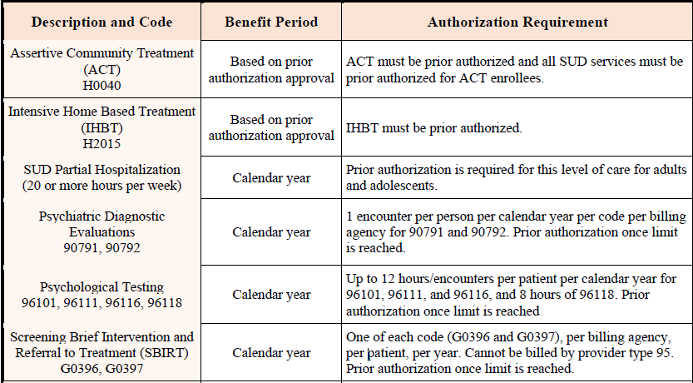
Authorization Requirements
Notes:
The limit on 96118 reflects 8 hours per year for 96118. If the provider exceeds 8 hours based on separate dates of service (not a single date of service), a report may be requested to for review.
PA with Act is related to substance use treatment with ACT. Any SUD service in addition to ACT will require a PA.

Slide 20
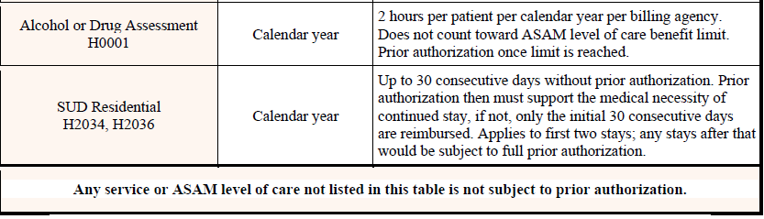
Authorization Requirements cont.
Notes:
The Procedure Codes if billed during ACT Authorization will require an Authorization for that Procedure Code. Ex H0006 is billed during the same time as an ACT procedure, then H0006 requires an Auth. (H0001,H0004, H0005, H0006, H0012, H0014, H0015, H0038, H0048, T1002, T1003: If this code is billed with a DOS that intersects with an authorization on file for ACT/H0040 or (IHBT/2015 only for H0006), than that code requires authorization. Claims should deny if authorization not on file. )

Slide 21
Authorization
Non-emergent situations
Emergent situations
Prior authorization can be obtained by a member, family member, or a provider. When calling UHC, be prepared to provide demographic information and a brief description of the presenting problem. UHC will explain the services available under their benefit plan.
A medical professional, a member, or a lay person in an emergency situation can identify the need for behavioral health services. Conditions that warrant an emergency admission are situations in which there is a clear and immediate risk to the safety of the member or another person as a direct result of mental illness or substance abuse.
Contact UHC for prior authorization of continued stay or additional care.
Authorization phone number: 1-866-261-7692

Slide 22
Prior Authorization Process
Request Via Phone
Request Via Portal (M-F 8 a.m. - 5 p.m. CST only)
Provider calls 1-866-261-7692
Provider selects the Mental Health/Substance use option
Provider services representative confirms eligibility/benefit questions
Call is transferred to Behavioral Health Care Advocate to complete the prior authorization
Provider logs in to www.unitedhealthcareonline.com
Provider verifies member eligibility through the portal
Provider enters authorization request on the portal
Authorization request information received by a Behavioral Health Care Advocate
Behavioral Health Care Advocate calls provider back to complete authorization process

Slide 23
Prior Authorization Continued
Uniform prior authorization form created for community BH services across all MCO’s
http://bh.medicaid.ohio.gov/manuals > Provider > Medicaid Managed Care Plans > Medicaid/MyCare Uniform Prior Authorization Form
Authorization fax number: 1-866-839-6454

Slide 24
Discharge Planning
Effective discharge planning addresses how a member’s needs will be met during transition from one level of care to another or to a different treating clinician
Planning begins at the onset of care and should be documented and reviewed over the course of care
Discharge treatment planning focuses on achieving and maintaining a desirable level of functioning after the completion of the current episode of care
Discharge instructions should be specific, clearly documented and provided to the member prior to discharge. For discharge from an acute inpatient program, the member’s follow-up appointment should be scheduled prior to discharge and should occur within seven days of the date of discharge
Throughout the treatment and discharge planning process, it is essential that members be educated regarding the importance of enlisting community support services, communicating treatment recommendations to all treating professionals, and adhering to follow-up care
Having a follow-up appointment and prescriptions at the time of discharge helps increase the member’s successful transition

Slide 25
Utilization Management Statement
Utilization Management decision-making is based only on the appropriateness of care as defined by
Medical Necessity Criteria
Level of Care Guidelines
Psychological and Neuropsychological Testing Guidelines
American Society of Addiction Medicine Criteria
UnitedHealthcare does not reward Medical Directors or licensed clinical staff
for issuing denials of coverage or service.

Slide 26
Outpatient Management
Reduce Administrative Burden
In-Scope Services
Management Strategy
We have removed precertification requirements for in-scope services
Individual/Group/Family Outpatient Therapy
Algorithms for Effective Reporting and Treatment (ALERT)
Practice Management

Slide 27
ALERT Program
Member Identification
Outreach
Potential Outcome
Claims data
Service combinations
Frequency and/or duration that is higher than expected
Licensed care advocate reach out telephonically to treating provider to:
Review eligibility for the service(s)
Review the treatment plan/plan of care
Review the case against applicable medical necessity guidelines
Close case (member is eligible, treatment plan/plan of care is appropriate, care is medically necessary)
Modification to plan (e.g., current care is not evidence-based but there is agreement to correct)
Referral to Peer Review (e.g., member appears ineligible for service; treatment does not appear to be evidence-based; duration/frequency of care does not appear to be medically necessary)

Slide 28
Practice Management Program
As an alternative to requiring precertification for routine and community-based outpatient services, we will provide oversight of service provision through our Practice Management Program.
Program Components
Regular and comprehensive analysis of claims data by provider/provider group
Service/diagnostic/age distribution
Proper application of eligibility criteria
Appropriate frequency of service/duration of service
Outreach to provider group when appropriate to discuss any potential concerns that arise from the claims analysis
Potential outcomes from discussion
No additional action necessary
Program audit including record review
Corrective Action Plan (CAP)
Targeted precertification as part of CAP

Slide 29
Billing and Claims

Slide 30
Claims Submission
Providers must submit claims using the current 1500 Claim Form or UB-04 with appropriate coding including, but not limited to ICD-10, CPT, and HCPCS coding
Please refer to your provider agreement related to timely filing of claims*
All claim submissions must include:
Member name, Medicaid identification number and date of birth
Provider’s Federal Tax I.D. number
National Provider Identifier (NPI) (unique NPI’s for rostered clinicians)
Providers are responsible for billing in accordance with nationally recognized CMS Correct National Coding Initiative (NCCI) standards. Additional information is available at www.cms.gov
When a provider is contracted as a group or facility, the payment is made to the group/facility and not to the individual clinician
Notes:
Point out contractual 90 days, BUT ODM mandated 180 timely filing for one year – 7/1/18 – 6/30/19 have 180 days for timely filing.

Slide 31
Claims Submission Process
How to submit:
Submit electronically
Accepting a wide variety of clearinghouses
www.UnitedHealthcareOnline.com
Secure portal to view eligibility, submit prior authorization request and submit claims for Medicaid members
Paper claims may be submitted to the following address:
United Healthcare Community Plan, PO Box 8207
Kingston, NY 12402-8207
What to include:
Submit claims with member’s subscriber ID number OR ODM’s MMIS ID number
Use Payer ID number 87726 for all UnitedHealthcare Community Plan claims
Notes:
Providers must be participating to submit claims on the portal a that requires them to create an account. We will pay non par agencies, but they will not be able to submit through the portal.

Slide 32
Electronic Payment & Statements (EPS)
With EPS, you receive electronic funds transfer (EFT) for claim payments, plus your EOBs are delivered online:
Lessens administrative costs and simplifies bookkeeping
Reduces reimbursement turnaround time
Funds are available as soon as they are posted to your account
To receive direct deposit and electronic statements through EPS you need to enroll at myservices.optumhealthpaymentservices.com > How to Enroll. Here’s what you’ll need:
Bank account information for direct deposit
Either a voided check or a bank letter to verify bank account information
A copy of your practice’s W-9 form
If you’re already signed up for EPS with UnitedHealthcare Commercial or UnitedHealthcare Medicare Solutions, you will automatically receive direct deposit and electronic statements through EPS for UnitedHealthcare Community Plan when the program is deployed.
Note: For more information, please call 866-842-3278, option 5, or go to UnitedHealthcareOnline.com > Help> Electronic Solutions > Electronic Payments and Statements

Slide 33
Third Party Payor (TPP) Coordination of Benefits (COB)
Effective January 1, 2018, where Medicare or private insurance coverage exists, payment must be sought from the TPP before Medicaid is billed.
Any payment received from a TPP must be reported on the claim or claims submitted to Ohio Medicaid.
Note: A claim that has been submitted to a TPP using a CPT code cannot be recoded to a HCPCS code to bill Ohio Medicaid.
Notes:
Again, from BH Redesign - reminder

Slide 34
Claims Tips
To ensure clean claims remember:
NPI numbers are always required for both rendering/billing provider on all claims
Obtain an NPI and enroll rendering clinicians in the Ohio Medicaid program and affiliate the clinician with the agency’s Medicaid ID number(s) in MITS
Modifiers, in addition to the NPI, are and will continue to be used for non-licensed/paraprofessional and non-independently licensed providers in order to differentiate service level by licensure and training for claims payment purposes*
A complete diagnosis is also required on all claims
Claims filing deadline
Providers should refer to their contract with Optum to identify the timely filing deadline that applies*
Claims Processing
Clean claims, including adjustments, will be adjudicated within 30 days of receipt*
Balance Billing
The member cannot be balance billed for behavioral services covered under the contractual agreement
Notes:
Stress modifier usage – this may be different than ODM and other MCO’s, but we MUST continue to get the modifier post 7/1/18. Multiple licensures - Clinicians only get 1 NPI and are responsible and own billing appropriate codes/modifiers for the services they render under their respective licensures. Additional information to come later in presentation.
Again point out contractual 90 days, but ODM mandated 180 days for first year – 7/1/18-6/30/19 timely filing is 180 days.

Slide 35
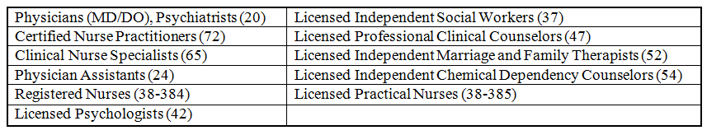
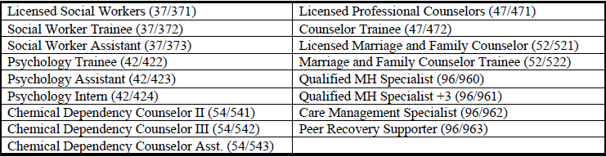
Rendering Practitioners
These practitioners are licensed by a professional board and are currently required to use their personal NPI as the rendering practitioner:
Effective 7/1/18, rendering practitioners are expanded to include the following:

Slide 36
Rendering Practitioners Continued
Remember: these providers will be required to have a National Provider Identifier (NPI) to render services to Medicaid enrollees AND they will be required to enroll in the Ohio Medicaid program. Agencies must also affiliate providers with the agency’s Medicaid ID number(s) in MITS. Additional information on MITS enrollment and Medicaid ID number affiliation:
http://mha.ohio.gov/Portals/0/assets/Planning/MACSISorMITS/mits-bits-rendering-providers-part-2-4-19-16.pdf
The rendering practitioner for behavioral health services must be listed on claims submitted to Ohio Medicaid for payment
Practitioners required to enroll in Medicaid must include their personal NPI in the rendering field on the claim for each service they provide
Those practitioners who are not required to enroll in Medicaid must leave the rendering field blank
Modifiers, in addition to the NPI, are and will continue to be used for non-licensed, paraprofessional, non-independently licensed providers and/or individuals holding more than one license or an assistant/trainee credential with differing scopes of practice in order to differentiate service level by licensure and training for claims payment purposes
Notes:
Stress modifiers and difference from Behavioral Health Provider Manual eff dates 1/1/18-6/30/18 for clinicians with multiple license levels – We MUST have modifiers post 7/1/18.
Refer to the supervising/ordering/rendering state document; RN/LPN services that require ordering by ordering specialty.

Slide 37
Overview of Supervision
Ohio Medicaid covers services provided by practitioners who, under state licensing, require supervision. The types of practitioners who may supervise is determined according to the appropriate licensing board.
Types of Supervision
General supervision: The supervising practitioner must be available by telephone to provide assistance and direction if needed.
Direct supervision: The supervising practitioner must be “immediately available” and “interruptible” to provide assistance and direction throughout the performance of the procedure; however, he or she does not need to be present in the room when the procedure is performed.
In order to be paid for services at the supervisor rate when performed by an unlicensed practitioner under direct supervision, the supervisor’s NPI must be included on the claim. Failure to report the direct supervisor’s NPI will result in a claim being adjudicated at the lower rate.

Slide 38
Supervision Continued
Reporting supervising NPI on the claim is optional. For practitioners listed below with direct supervision, the service will be paid at direct supervisor’s rate when supervisor NPI is included in the header of the claim. If the supervisor NPI is not included on the claim indicating the service is provided under general supervision, the service will be paid at 72.25% of maximum fee
Practitioners requiring supervision must be supervised at all times, including supervisor sick days, trainings, vacations, etc.
Each licensing board regulates supervision requirements for their provider types and may have specific requirements pertaining to supervisor coverage during absences. In the absence of board guidance on supervisor coverage, Ohio Medicaid does not require practitioners to be assigned to a specific supervisor, therefore, any qualified supervising practitioner permitted by the practitioner’s respective licensing board’s OAC may provide coverage during absences but must assume all supervision responsibilities, including signing off on services provided

Slide 39
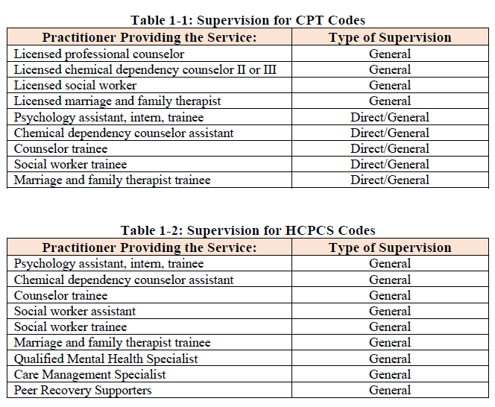
Practitioners Requiring Supervision per Ohio Medicaid

Slide 40
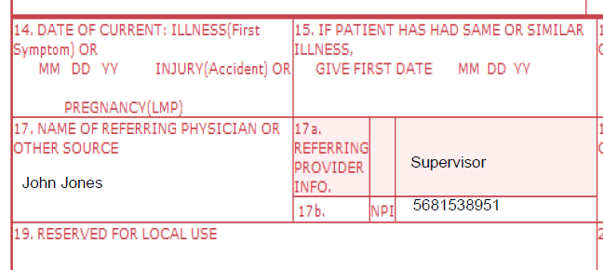
Supervising Provider’s NPI on Claims
Box 17: Enter the supervising provider’s name in box 17. Insert the word “supervisor” in box 17a. Enter the supervising provider’s NPI in box 17b.
Line Level Loop 2420D (Supervisor) – with Entity Identifier Code DQ (Supervisor)
Notes:
Line Level Loop 2420D (Supervisor) – with Entity Identifier Code DQ (Supervisor)

Slide 41
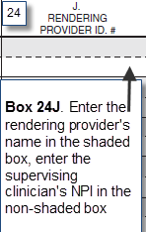
Supervising Provider’s NPI on Claims
Box 24J: Enter the rendering provider’s name (may be non-licensed) in the shaded portion, and the NPI number of the independently licensed supervising clinician in the non-shaded portion
Box 24J and Claim Header Loop 2310B
If there are multiple providers on the bill, verify the Individual Provider in box 24J and 2420A.
Notes:
Box 24 J and Claim Header Loop 2310B
If there are multiple providers on the bill, verify the Individual Provider in box 24J and 2420A.

Slide 42
Practitioner Modifiers
It is extremely important to accurately report modifiers as they are used to count towards soft limits, price services and adjudicate claims appropriately
Modifiers are always two characters in length. They may consist of two numbers from 21 to 99, two letters, or a mix (alphanumeric)
Ohio Medicaid will accept modifiers in any order, however, modifier fields must be populated in order from one to four (the first modifier field must be populated before the second modifier field, etc.)
Remember: Modifiers, in addition to the NPI, are and will continue to be used for non-licensed, paraprofessional, non-independently licensed providers and/or individuals holding more than one license or an assistant/trainee credential with differing scopes of practice in order to differentiate service level by licensure and training for claims payment purposes.
Notes:
Again, stress modifier usage post 7/1/18 – this DIFFERS from ODM Provider Manual

Slide 43
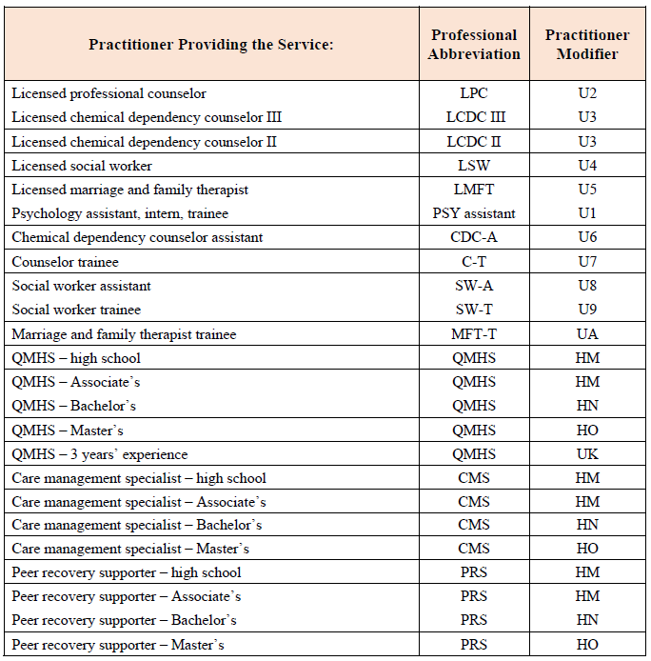
Required Modifiers

Slide 44
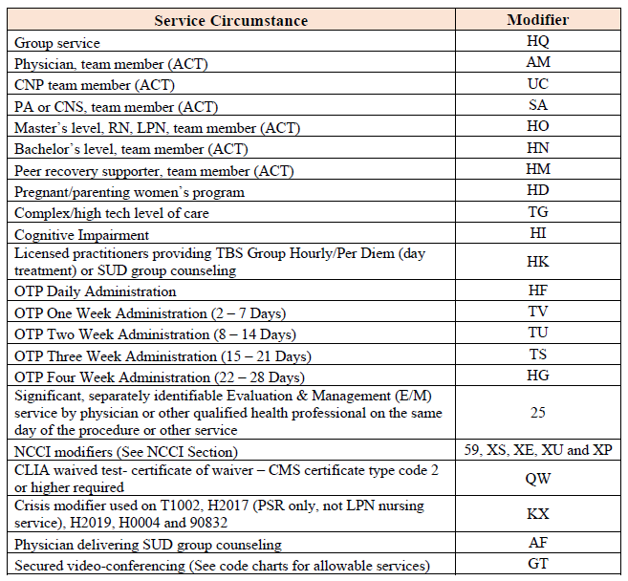
Procedure Modifiers

Slide 45
Interactive Complexity
Interactive complexity refers to specific communication factors that complicate the delivery of a psychiatric procedure and occur during the delivery of the service.
Common factors include more difficult communication with discordant or emotional family members and engagement of young and verbally underdeveloped or impaired patients.
This add-on code may be reported in conjunction with:
Psychiatric Diagnostic Evaluation (90791, 90792)
Psychotherapy (90832, 90834, and 90837)
Psychotherapy add-ons (90833, 90836, and 90838)
Group Psychotherapy (90853)

Slide 46
Interactive Complexity Continued
Include 90785 in addition to the primary procedure, when at least one of the following communication factors is present during the visit:
The need to manage maladaptive communication (related to, e.g., high anxiety, high reactivity, repeated questions, or disagreement) among participants that complicates delivery of care
Caregiver emotions or behaviors that interfere with implementation of the treatment plan
Evidence or disclosure of a sentinel event and mandated report to a third party (e.g., abuse or neglect with report to state agency) with initiation of discussion of the sentinel event and/or report with patient and other visit participants
Use of play equipment, physical devices, interpreter or translator to overcome barriers to diagnostic or therapeutic interaction with a patient who is not fluent in the same language or who has not developed or lost expressive or receptive language skills to use or understand typical language

Slide 47
Interactive Complexity Continued
Interactive complexity is often present with patients who:
Have other individuals legally responsible for their care, such as minors or adults with guardians, or
Request others to be involved in their care during the visit, such as adults accompanied by one or more participating family members or interpreter or language translator, or
Require the involvement of other third parties, such as child welfare agencies, parole or probation officers, or schools
The following examples are NOT interactive complexity:
Multiple participants in the visit with straightforward communication
Patient attends visit individually with no sentinel event or language barriers
Treatment plan explained during the visit and understood without significant interference by caretaker emotions or behaviors

Slide 48
Place of Service Codes
Providers must accurately identify and report on each claim detail line where a service took place using the most appropriate CMS place of service code.
Services Delivered in an Inpatient or Outpatient Hospital Setting
If a provider wishes to provide services in an inpatient or outpatient hospital setting, they must contract with the hospital to receive reimbursement for those services, as the payment of these services is included in the payment to the facility.
“Other Place of Service” Setting
Place of service “99-Other Place of Service” has been redefined for Ohio Medicaid as Community.
POS Code 99 may only be used when a more specific place of service is not available
POS Code 99 shall not be used to provide services to a recipient of any age if the recipient is in custody and held involuntarily through the operation of law enforcement authorities in a public institution

Slide 49
Claims Detail Rollup for Same Day Services
When the same service(s) are provided to the same patient on the same day, claims need to be “rolled up” and submitted as one detail line even if the services are not provided continuously on the same day.
The implementation of rendering practitioner NPI, supervisor NPI, and practitioner modifier (U modifier) requirements changed the claims rolling process effective January 1, 2018.
Services that need to be rolled must be rolled by the same date of service, same client, same HCPCS code, same modifier(s), same individual rendering practitioner NPI, same supervisor NPI, and same place of service.
When more than one practitioner is facilitating an IOP and/or PH group counseling service, claims are billed under the highest level practitioner.

Slide 50
Claims Detail Rollup: Example 1
Amy Smith, RN (NPI 9876543210) and John Jones, RN (NPI 9876543211) each provide two 15-minute nursing services (H2019) to Betty Brown. The correct way to bill these services is by submitting two detail lines on a single claim.
Claim detail one would be: Amy Smith, RN, NPI in rendering provider field: 9876543210, with two units of H2019.
2. Second claim detail would be: John Jones, RN, NPI in rendering provider field: 9876543211, with two units of H2019.
It would be inappropriate to roll these services under either just Amy or John and bill 4 units of H2019 since Amy and John are separately enrolled in MITS with their own unique NPIs
Claims with practitioners who are not required to individually enroll in Medicaid are rolled at the same date of service, same supervisor NPI, same place of service, same practitioner and other modifier(s)

Slide 51
Claims Detail Rollup: Example 2
Two different LSWs provide individual CPST to the same client on the same day under the same supervisor and at the same place of service (office).
These services must be rolled as they use the same practitioner modifier (U4) and the rendering provider field is blank.
However, if a LSW and a LPC provide individual CPST to the same client on the same day, those services may not be rolled because the practitioner modifiers are different (U4 and U2, respectively).

Slide 52
National Drug Code (NDC)
With the exception of hospital claims, federal law requires that any code for a drug covered by Medicaid must be submitted with the 11-digit NDC assigned to each drug package
The NDC specifically identifies the manufacturer, product and package size
Each NDC is an 11-digit number, sometimes including dashes in the format 55555-4444-22
When submitting claims to Medicaid, providers should submit each NDC using the 11-digit NDC without dashes or spaces
The NDC included on the claim must be the exact NDC that is on the package used by the provider
The NDC will be required at the detail level when a claim is submitted with a code that represents a drug (e.g., J-codes and S-codes)

Slide 53
National Drug Code (NDC) Continued
Some drug packages include a 10-digit NDC. In this case, the provider should convert the 10 digits to 11 digits when reporting this on the claim.
When converting a 10-digit NDC to an 11-digit NDC, a leading zero should be added to only one segment:
If the first segment contains only four digits, add a leading zero to the segment
If the second segment contains only three digits, add a leading zero to the segment
If the third segment contains only one digit, add a leading zero to the segment

Slide 54
Missed Appointments
There are no procedure codes for missed appointments, (i.e., cancellations and/or “no shows”).
A missed appointment is a “non-service” and is not reimbursable by Ohio Medicaid.
Per state and federal guidelines, Medicaid clients cannot be charged a “missed appointment fee.”
Per the CMS Medicare Program Integrity Manual, missed appointments should be documented in the clinical record.

Slide 55
Laboratory Codes
CLIA Certification Overview
To bill laboratory codes, a provider must obtain the appropriate CLIA certification and enroll as a laboratory provider with Ohio Medicaid.
These laboratory services under CLIA are carved into Managed Care and payment must be coordinated with the individual plans
The Laboratory Certification Program works to ensure Ohio residents receive accurate, cost-effective clinical laboratory testing as a part of their health care
New Applications
Generally, each separate location or address is required to have a separate CLIA number
There are exceptions for not-for-profit/government-owned laboratories or hospitals. Call the Ohio Department of Health if you think your organization qualifies for one of these exceptions

Slide 56
Claims Contact Information
Prior Authorization | UnitedHealthcare at 1-866-261-7692
Paper Claim Submission | Mail paper claims to: United Healthcare Community Plan PO Box 8207 Kingston, NY 12402-8207
Electronic Claim Submission | Through Link or via EDI clearing house Payor ID 87726
Claims Status | Web portal at Link on UnitedHealthcareOnline.com
Claims Appeals Eligibility Verification Provider Service Center | United Healthcare Community Plan Appeals and Grievances PO Box 31364 Salt Lake City, UT 84131-0364 View eligibility online at Link on UnitedHealthcareOnline.com 800-600-9007 for Community Plan Customer Service
Update Practice Information | providerexpress.com or via 877-614-0484

Slide 57
Appeals and Grievances

Slide 58
Appeals
Non-Urgent (Standard)
Urgent (Expedited)
Must be requested within 90 days from receipt of the Notice of Action letter
When an appeal is requested, Optum will make an appeal determination and notify the provider, facility, member or authorized member representative in writing within 45 calendar days of receipt of request
Must be requested as soon as possible after the Adverse Determination
Optum will make a reasonable effort to contact you prior to making a determination on the appeal. If Optum is unsuccessful in reaching you, an urgent appeal determination will be made based on the information available to Optum at that time
Notification will occur as expeditiously as the member’s health condition requires, within two (2) business days, unless the appeal is pertaining to an appeal relating to an ongoing emergency or denial of continued hospitalization, which we will complete investigation and resolution of no later than one (1) business day after receiving the request
Appeal requests can be made verbally or in writing.
Verbal requests must be followed with a written and signed appeal.

Slide 59
Services While in Appeal
You may continue to provide service following an adverse determination if the following are met:
The member is informed of the adverse determination
The member is informed that the care will become the financial responsibility of the member from the date of the adverse determination forward
The member agrees in writing to these continued terms of care and acceptance of financial responsibility
You charge no more than the United contracted fee for such services, although a lower fee may be charged
If, subsequent to the adverse benefit determination and in advance of receiving continued services, the member does not consent in writing to continue to receive such care and we uphold the determination regarding the cessation of coverage for such care, you cannot collect reimbursement from the member pursuant to the terms of your Agreement

Slide 60
Appeals and Grievances
Claims reconsideration through:
www.UnitedHealthcareOnline.com > Claims & Payments > Claim Reconsideration
Corrected claims or any paper attachments to be submitted via Optum Cloud.
Appeals & Grievances mailing address
UnitedHealthcare Community Plan
UnitedHealthcare Community Plan of Ohio
P.O. Box 31364
Salt Lake City, UT 84131-0364
Call 800-600-9007 for Community Plan Customer Service

Slide 61
Member Information

Slide 62
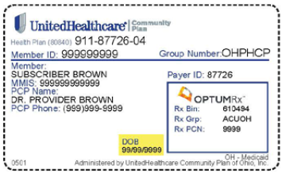
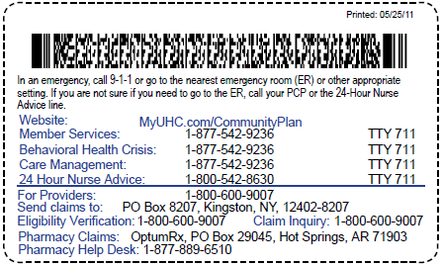
Member Verification
All relevant contact information will be on the back of the card for both medical and behavioral customer service.
Please note this image is for illustrative purposes only.

Slide 63
Member Rights and Responsibilities
Members have the right to be treated with respect and recognition of his or her dignity, the right to personal privacy, and the right to receive care that is considerate and respectful of his or her personal values and belief system.
Members have the right to disability related access per the Americans with Disabilities Act.
You will find a complete copy of Member Rights and Responsibilities in the Network Manual.
These can also be found on the website: providerexpress.com
These rights and responsibilities are in keeping with industry standards. All members benefit from reviewing these standards in the treatment setting.
We request that you display the Rights and Responsibilities in your waiting room, or have some other means of documenting that these standards have been communicated to the members.

Slide 64
Provider Resources

Slide 65
Access to Care – Standards

Slide 66
Access to Care – Standards Continued

Slide 67
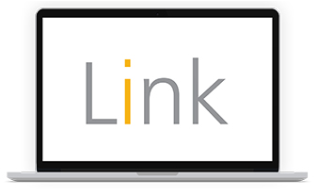
Link
Link is the new gateway to our online tools
Use Link applications to help simplify daily administrative tasks:
Check Member eligibility and benefits
Submit and manage claims
Review coordination of benefits information
Use the integrated applications to complete multiple transactions
View care opportunity information for UnitedHealthcare Members
To register for Link, sign in to www.unitedhealthcareonline.com using your Optum ID or click “New User” if you do not have an Optum ID. If you have questions, please call the Optum Support Center at 855-819-5909.

Slide 68
UnitedHealthcare Provider Website
For important UnitedHealthcare Community Plan-specific information visit UHCCommunityPlan.com > For Health Care Professionals > Ohio to see:
Provider Directory
Claims and Member information
Clinical Practice Guidelines
Provider Forms
Reimbursement Policies
Provider News, Alerts and Trainings
Pharmacy and Drug information

Slide 69
Other Online Tools & Resources
Liveandworkwell.com
Member and family education and support
Also available in Spanish
providerexpress.com
Level of Care, Best Practice and Coverage Determination Guidelines
Provider demographic changes / Roster management
Welcome to our network – MyCare Ohio and Medicaid specific
news, trainings, notifications
http://bh.medicaid.ohio.gov/manuals*
Notes:
Stress bh.medicaid.ohio.gov/manuals

Slide 70
Network Participation

Slide 71
M-BHPs and I-BHPs
Licensed by a professional board in the state of Ohio
Have specialty experience and/or training related to persons with behavioral health conditions.
Medical Behavioral Health Providers
Licensed Independent Behavioral Professionals
Authorized to practice some level of general medicine
Physicians
Clinical nurse specialists
Clinical nurse practitioners
Registered nurses
Licensed practical nurses
Physician assistants
Authorized to practice independently
Psychologists
School psychologists
Licensed professional clinical counselors
Licensed independent social workers
Licensed independent marriage and family therapists
Licensed independent chemical dependency counselors
Notes:
Again Dual licensures - Clinicians only get 1 NPI and are responsible and own billing appropriate codes/modifiers for the services they render under their respective licensures

Slide 72
BHPs ̶ Behavioral Health Professionals
Licensed by a professional board in the state of Ohio
Have specialty experience and/or training related to persons with behavioral health conditions.
Authorized to practice under direct or general clinical supervision
Licensed
Trainees/Assistants
Board licensed school psychologists
A licensed professional
A licensed social worker
A licensed marriage and family therapist
A licensed chemical dependency counselor III
A licensed chemical dependency counselor II
A psychology assistant/intern/trainee
A school psychology assistant/intern/trainee
A counselor trainee
A social work trainee
A social work assistant
A marriage and family therapist trainee
A chemical dependency counselor assistant
These providers still need to be identified by a modifier when billing post 7/1/18.

Slide 73
BHP-Ps ̶ Behavioral Health Paraprofessionals
NOT licensed by a professional board in the state of Ohio
Specially trained to provide a specialty service or services to persons with or in recovery from substance use disorders (SUD) and/or mental health (MH) conditions
Peer Recovery Supporter (PRS)
Care Management Specialist (CMS)
Qualified Mental Health Specialist (QMHS)
These providers still need to be identified by a modifier when billing post 7/1/18.

Slide 74
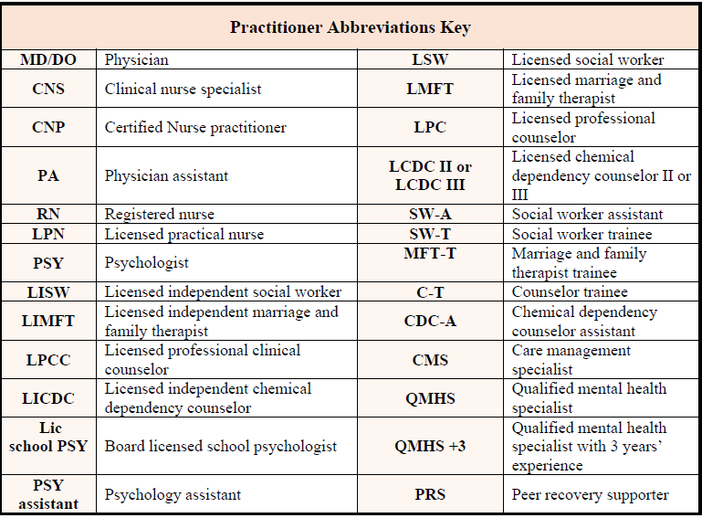
Practitioner Abbreviations Key

Slide 75
Joining Our Network
CMHCs, AODs, and other agencies:
For agencies that employ licensed professional staff to render services under the umbrella of the agency, Optum will execute group contracts with the agency as the contracting entity
Agencies must submit the Optum agency application, indicating the services being provided and the licensed clinical professionals on the staff roster
The individual licensed clinicians on staff do not need to submit CAQH applications or be individually credentialed when they work for the agency under an Optum group contract
Please contact your Optum Network Manager via OhioNetworkManagement@Optum.com to obtain the agency application and group contract as appropriate
Notes:
Individuals and Facilities not included – NPRF and FNRF – CAQH and Application – Higher LOC for commercial/Medicare Facility, but for Medicaid – anything lower than IP is covered on your outpatient agreement/fee schedule

Slide 76
Agency Maintenance and Roster Updates
All ODM rendering clinicians should be listed on the agency’s roster included in the agency’s initial credentialing application
Optum will be responsible for maintaining Medicaid and MyCare rosters for participating agencies using data provided by ODM*
It is critical that MITS is updated with rendering clinicians and that clinicians are affiliated with the agency’s Medicaid ID number(s) so Optum can ensure accurate roster maintenance for claims payment purposes
Optum Network Management may contact agencies for clarity and verification in the event roster discrepancies are found, but agency’s must take action in MITS with regard to their affiliated clinicians
Proactive submission of rosters is not required for Medicaid and MyCare, but will be accepted and reviewed via the Agency Roster Update Form or through your secure account on www.providerexpress.com*
The provider must be found in and affiliated with the agency in MITS
Notes:
For commercial/Medicare, agencies are still contractually obligated to provide us with additions/terminations

Slide 77
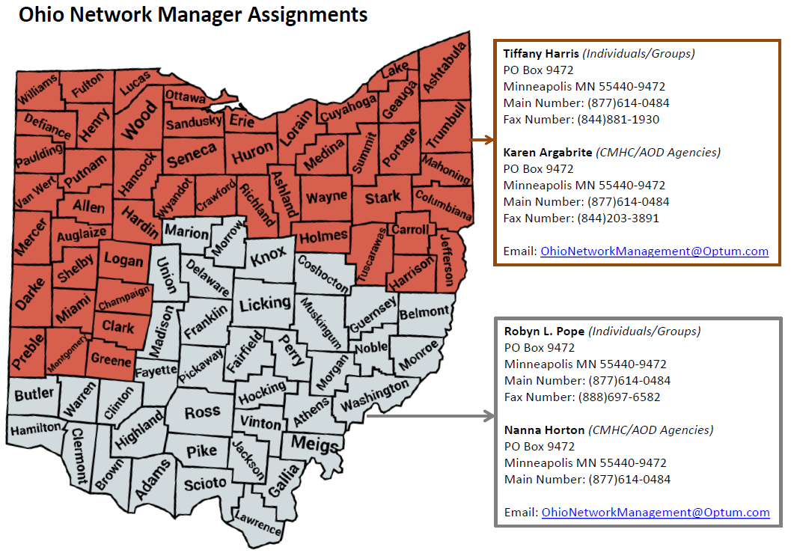
Optum Network Management
Elizabeth D. Jackson, Network Manager
Phone: 804-267-5236
Email: Elizabeth.Jackson@Optum.com
Robyn L. Pope, Network Manager
Phone: 713-599-5502
Email: Robyn.Pope@Optum.com
Urgent Post Go Live Issues:
OhioNetworkManagement@Optum.com

Slide 78
Thank you

